Slide 1
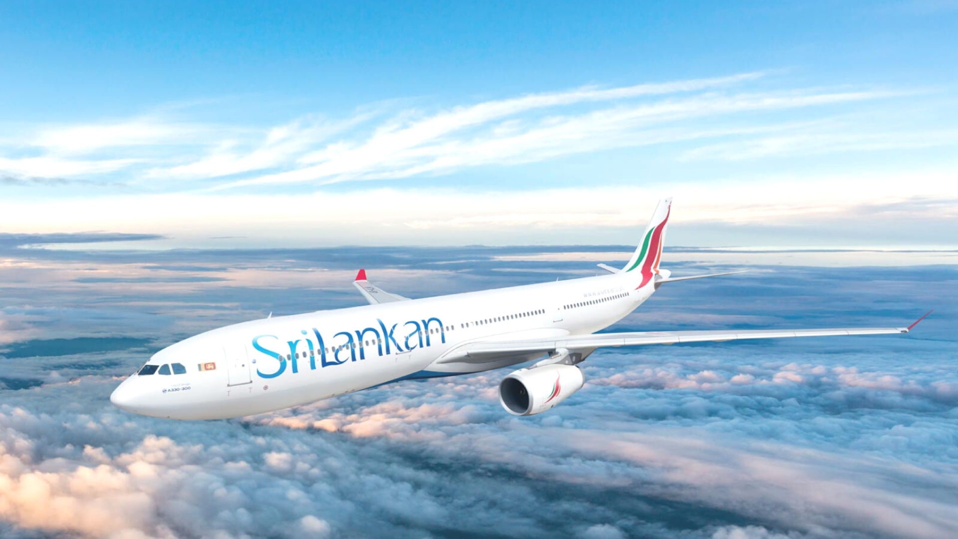
WELCOME TO OUR WEBSITE(First flight travels)

Slide 2
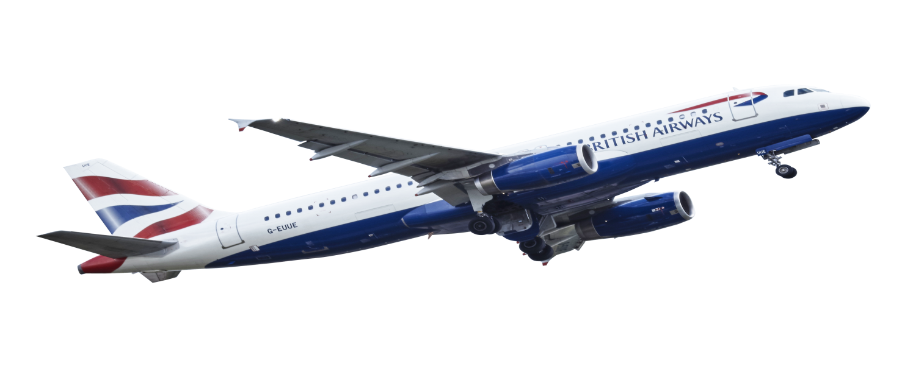
Firstflight travels
(Brahmbhatt sahil)

Slide 3

Silver Oak College Of Computer Application
Projrct Name : flight trip
Student Name : Brahmbhatt sahil
Project Guide : Meghana mam
Department : BCA (Sem-2)
Div : M1A3
Subject : Create Website with PPT

Slide 4
Describation
Introduction
Purpose
Benefite
Difference Between Other Website and My Websit

Slide 5
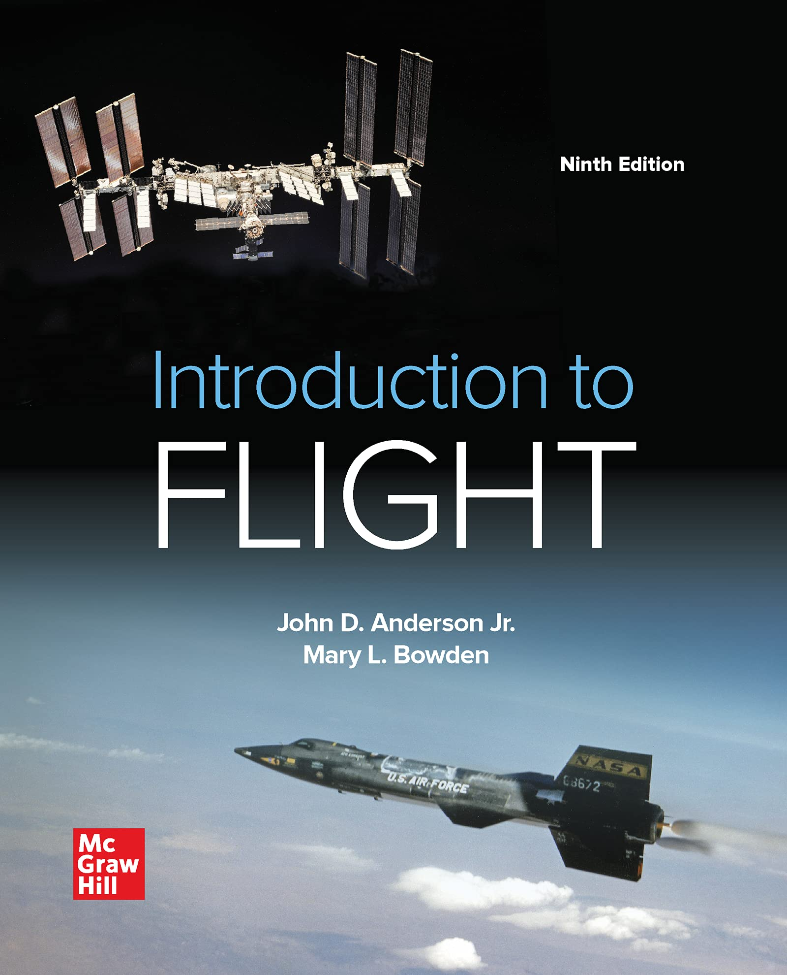
Introduction
Introduction to Flight blends history and biography with discussion of engineering concepts, and shows the development of flight through this perspective.

Slide 6
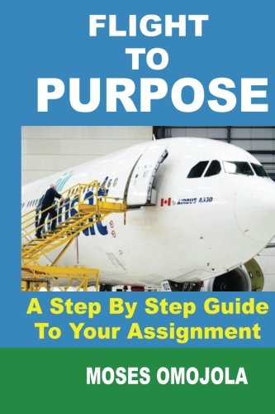
Purpose
An first flight reservation website allows a customer to specify their travel requirements such as the city of departure, destination, departure date, return date and class of travel

Slide 7
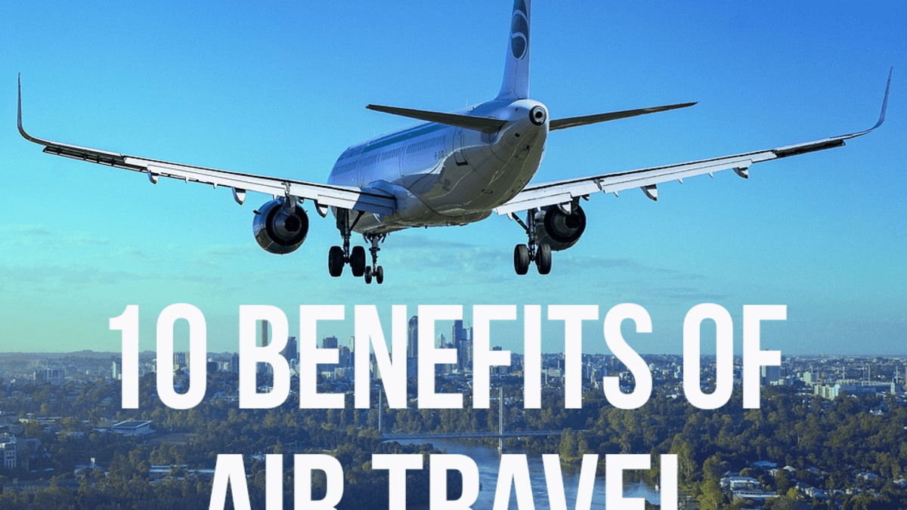
Benefite
The days of going to a travel agent and booking your tickets is far behind us. As a result of the internet and many travel websites, you can now easily book your flight tickets from the comfort of your own home. Booking flight tickets online has many advantages that you may not be aware of. These advantages may vary from comparing different airline fares to quick and easy access to flights; also it allows you to directly receive your boarding pass directly to your email or through messages.

Slide 8
Difference Between Other Website and My Website
First Flight Travel
Make My Trip
1. Low Cost For First Flight Travel.
2.Check all the First Flight Travel
websites available.
3.Enter your details on an aggregator website.
4.Choose your stops.
5.Choose your seat.
6.Direct Bookings and Indirect Bookings.
1High cost For Make My Trip.
2.Check all the Make My Trip
websites available.
3.Enter your details on an aggregator website.
4.Choose your stops.
5.Choose your seat.
6. Direct Bookings.

Slide 9
Thank You

